Slide 1
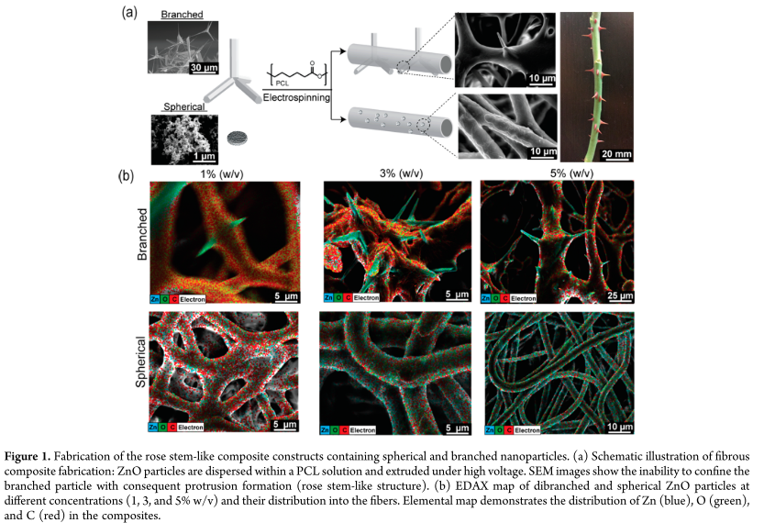
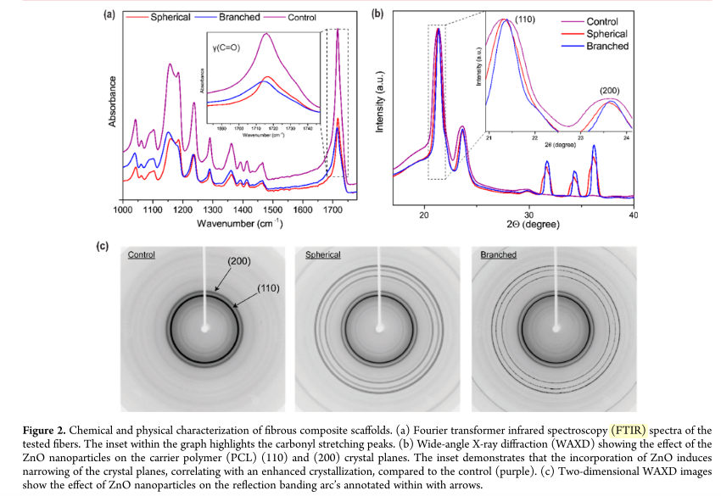
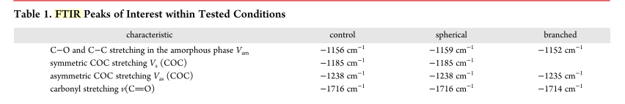
﻿Nanostructured Fibrous Membranes with Rose Spike-Like Architecture
Amir Nasajpour et al. ”Nanostructured Fibrous Membranes with Rose Spike-Like Architecture” Nano Lett. 2017, 17, 6235−6240

